Slide 1

ALD Process for Top-Gating 2D Materials ENGR241 Autumn
Akash Levy, Jung-Soo Ko
Mentors: J. Provine, Michelle Rincon, Vijay Narasimhan

Slide 2
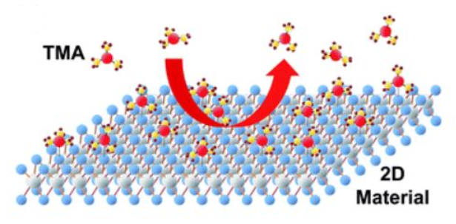
Introduction
Uniform and full coverage of high-k gate dielectrics is essential for top-gated 2D devices
ALD is difficult due to lack of dangling bonds
No recipe exists in SNF for depositing high-k on 2D
Only alumina has been tried from ALD tool in Pop lab (not in SNF)
Seed layer thickness must be optimized
Film quality has not been characterized
Goal: Develop process flow for ALD top-gating on 2D for reliable and controlled growth of high-k materials
CVD-grown monolayer MoS₂ on SiO₂/Si samples will be provided from Pop group

Slide 3
Benefit to SNF
Process flow for top gating on 2D materials
Characterization (electrical, surface image) with
Different seed layer thickness
Different seed layer material
Recipe for ALD on 2D materials and samples with seed layer
→All available with tools in SNF! (but 2D material samples were provided from Pop Group in EE)

Slide 4
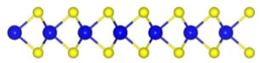
Structure and Process Flow
1. E-beam evaporate (AJA) Al
On prepared MoS2 for surface characterization
On SiO2/Si substrate for electrical characterization
2. Oxidize in air → becomes alumina
3. ALD (Fiji2) alumina on oxidized seed layer
4. E-beam evaporate Ti/Au for top electrode for e-charac
Gate Oxide
Evaporated Seed Layer
2D TMD
SiO2
Metal Oxide
Seed layer
Seed layer
Seed layer
SiO2
AJA
SiO2
Air
SiO2
Fiji
SiO2
Si
Si
Si
Si

Slide 5
Electrical Characterization
Normalized breakdown voltage seems to decrease with larger target seed layer thicknesses
Dielectric constant increases with larger seed layer thicknesses
Need more data to verify and reduce error bars: also will test with hafnia

Slide 6
Surface Characterization
Prepared MoS₂ sample: RMS ~0.197nm
RMS of ALD w/o seed layer
ALD alumina 5nm ~1.036nm, 10nm ~0.914nm
Thicker seed layer before ALD → Rougher surface
Thicker seed layer after ALD → Smoother surface
 | Total 5nm alumina (oxidized seed layer+ALD)
Al seed layer (nm) | 0.5 | 1 | 1.5 | 2
average RMS (nm) | 0.538 | 0.505 | 0.400 | 0.245
 | Total 10nm alumina (oxidized seed layer+ALD)
Al seed layer (nm) | 0.5 | 1 | 1.5 | 2
average RMS (nm) | 0.428 | 0.307 | 0.277 | 0.205

Slide 7
Conclusion
Electrical characterization
Surface characterization
On Si substrate, with MIM structures…
Normalized breakdown voltage seems to decrease with larger target seed layer thicknesses
Dielectric constant increases with larger seed layer thicknesses
Seed layer deposition creates nucleation sites on 2D materials
Roughness decreases as seed layer thickness increases
Roughness variation is large on same sample
Mark samples first and measure same flakes (next quarter plan)

Slide 8
Next Quarter Plan: Top-gating 2D-Devices
MOSFET structure for I-V measurement
C-V for extracting dielectric constant is difficult due to ultrathin film (~0.65nm for 1L MoS₂)
Different seed material & ALD material
Various oxides available in Fiji & Different seed layer i.e. Hf
PEALD on 2D materials
Potential damage on surface due to plasma
Mark samples to measure on same flake (or spot) using litho
Potential PR residue problem
G
S
HKMG
D
SiO2
Si
MoS2 Sample
Contact Pads (Litho & AJA)
HKMG Seed layer (AJA)
ALD(Fiji 1/2)
Gate Electrode (AJA)
Liftoff
Litho (S/D patterning)
S/D Electrode (AJA)
Liftoff
Litho (Gate Patterning)
Litho (Channel Patterning)
O₂ Plasma etch

